Slide 1
Topics
Basic knowledge review
Hand “CNI” with Linux tools

Slide 2
0. Prerequisites
Network protocol stack(MAC/ARP/IP/ICMP/TCP/UDP)
Bridging/Switching(VLAN/VxLAN) and Routing(subnet/netmask, gateway/nexthop, route lookup)
Linux commands(ip, iptables, conntrack, …)
Container/Linux namespaces(Network, Mount, UTS, IPC, User)
Kubernetes installation and operation
Notes:
Wolf 秦柯 TCP IP
CCNA/JNCIA
马哥教育

Slide 3
1. Linux host(Network protocol stack) is a Multi-Function Router/Switch/Firewall
NICs
Network Namespace(ip netns)
tun/tap(virtual NIC)
bridge(ip, bridge(iproute2)/brctl(bridge-utils))
veth pair
iptables
Notes:
Enable IPv4 forwarding:
# echo 1 > /proc/sys/net/ipv4/ip_forward
How to confirm which 2 veth interfaces are a pair:
ethtool –S eth0
ip link show eth0
cat /sys/class/net/eth0/iflink; cat /sys/class/net/vethxxxx/ifindex

Slide 4
VM 1
Application 1
Pod F
Pod H
Pod C
VM 2
Application 2
VM N
Application N
Pod V
OpenVPN
tap
tun
Socket API Layer
Linux Bridge
Linux Bridge
Network Protocol Stack
NIC
Linux Kernel
NIC
Linux Host
Notes:
Tap: Layer 2 virtual NIC
Tun: Layer 3 virtual NIC
Veth pair: veth1@veth2, veth2@veth1
Linux bridge: slave ports can be tap, veth, NIC

Slide 5
vnet#6/host-only
192.168.210.0/24
swp1/vlan210
192.168.210.254/24
Leaf03
swp2/vlan230
192.168.230.254/24
vnet#7/host-only
192.168.230.0/24
mgmt/eth0
192.168.100.103/24
enp0s9
192.168.210.21/24
enp0s9
192.168.210.22/24
enp0s9
192.168.230.23/24
worker1
worker2
worker3
enp0s8
192.168.100.21/24
enp0s8
192.168.100.22/24
enp0s8
192.168.100.23/24
vnet/host-only
192.168.100.0/24
Laptop

Slide 6
Hand CNI - 1 Containers connected under Linux bridge on the same node
Diagram(container-to-container)
netns1
192.168.10.1/24
netns3
192.168.10.3/24
eth0
eth0
veth1
veth3
br0
Network Stack
worker1.k8s.com

Slide 7
Hand CNI - 2 Containers connected to host network stack on the same node
Diagram(container-to-container)
netns1
192.168.10.1/32
netns3
192.168.10.3/32
eth0
192.168.10.254/32
eth0
veth1
veth3
Network Stack
worker1.k8s.com
Notes:
How to avoid wasting IP addresses in such scenario:
Use /31 for each netns, which will waste one IP address for each netns
Use /32 for each netns, which makes the veth pair as a point-to-point link, and we can use the same IP for all veth belongs to the host Network Stack.(We also use an IP of other physical interface as well, or a link local IP address, or enable proxy_arp for veth and don’t assign any IP)
https://askubuntu.com/questions/893097/how-to-get-rid-of-169-254-0-0-route
# vi /etc/network/if-up.d/avahi-autoipd
….
if [ -x /bin/ip ]; then
# route already present?
ip route show | grep -q '^169.254.0.0/16[[:space:]]' && exit 0
/bin/ip route add 169.254.0.0/16 dev $IFACE metric 1000 scope link
elif [ -x /sbin/route ]; then
# route already present?
/sbin/route -n | egrep -q "^169.254.0.0[[:space:]]" && exit 0
/sbin/route add -net 169.254.0.0 netmask 255.255.0.0 dev $IFACE metric 1000
fi

Slide 8
Break 1

Slide 9
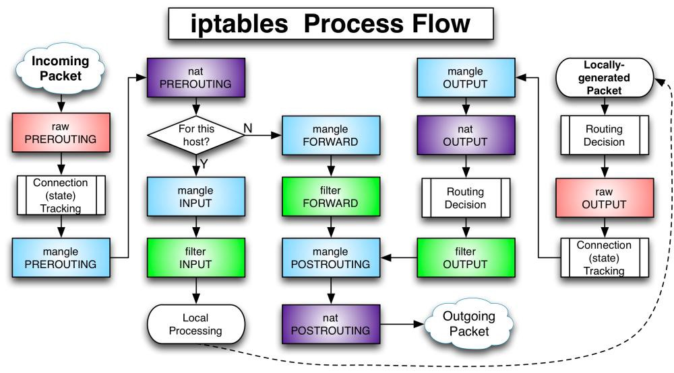
https://n0where.net/how-does-it-work-iptables

Slide 10
Hand CNI - 3 Container connected under Linux bridge go to outside
Diagram(container-to-outside)
netns1
192.168.10.1/24
eth0
veth1
br0
192.168.10.254/24
enp0s9
192.168.210.21/24
worker1.k8s.com
swp1: 192.168.210.254/24
Leaf03

Slide 11
Pod 1
Socket API Layer
Linux Bridge
Network Protocol Stack - Netfilter
POSTROUTING - mangle
FORWARD - filter
PREROUTING - raw
POSTROUTING - Snat
FORWARD - mangle
Connection Tracking
N
For this host?
PREROUTING - nat
PREROUTING - mangle
Linux Kernel
NIC
Linux Host
Notes:
Iptables –vnL –t nat
conntrack -L

Slide 12
Hand CNI - 4 Client container access ClusterIP whose backend container is on the same node
Diagram(container-to-ClusterIP_service)
Client netns1
192.168.10.1/24
HTTP service
192.168.10.200:80
Server netns3
192.168.10.3/24
eth0
ClusterIP
11.96.10.3:8080
eth0
veth1
veth3
br0
192.168.10.254/24
worker1.k8s.com

Slide 13
Service Pod
Client Pod
Linux Bridge
Network Protocol Stack - Netfilter
POSTROUTING - mangle
POSTROUTING - nat
PREROUTING - raw
FORWARD - filter
Connection Tracking
N
For this host?
FORWARD - mangle
PREROUTING - Dnat
PREROUTING - mangle
Linux Kernel
NIC
Linux Host
Notes:
Iptables –vnL –t nat
conntrack -L

Slide 14
Hand CNI - 5 Outside or Client container access NodePort whose backend container is on the same node
Diagram(outside-to-NodePort_service)
HTTP service
192.168.10.3:80
Server netns3
192.168.10.3/24
eth0
veth3
br0
192.168.10.254/24
enp0s9
192.168.210.21/24
NodePort
192.168.210.21:32080
worker1.k8s.com
swp1: 192.168.210.254/24
Leaf03

Slide 15
Service Pod
Application
Linux Bridge
Network Protocol Stack - Netfilter
POSTROUTING - nat
Routing
Decision
POSTROUTING - mangle
OUTPUT - raw
PREROUTING - mangle
PREROUTING - Dnat
Connection Tracking
Connection Tracking
OUTPUT - filter
OUTPUT - mangle
FORWARD - filter
PREROUTING - raw
N
Routing
Decision
OUTPUT - Dnat
For this host?
FORWARD - mangle
Linux Kernel
NIC
Linux Host
Notes:
Iptables –vnL –t nat
conntrack -L

Slide 16
Break 2

Slide 17
Hand CNI - 6 Containers connected under Linux bridges on different nodes - IPIP
Diagram(container-to-container)
netns1
192.168.10.1/24
netns1
192.168.30.1/24
eth0
tunl0
192.168.10.2/32
tunl0
192.168.30.2/32
eth0
veth1
veth1
br0
192.168.10.254/24
br0
192.168.30.254/24
worker1.k8s.com
enp0s9
192.168.210.21/24
worker3.k8s.com
enp0s9
192.168.230.23/24
Route | NextHop
192.168.210.0/24 | swp1
192.168.230.0/24 | swp2
br0
192.168.20.254/24
tunl0
192.168.20.2/32
enp0s9
192.168.210.22/24
swp1
192.168.210.254/24
swp2
192.168.230.254/24
worker2.k8s.com
Notes:
https://developers.redhat.com/blog/2019/05/17/an-introduction-to-linux-virtual-interfaces-tunnels#ipip_tunnel
When the ipip module is loaded, or an IPIP device is created for the first time, the Linux kernel will create a tunl0 default device in each namespace, with attributes local=any and remote=any.
When receiving IPIP protocol packets, the kernel will forward them to tunl0 as a fallback device if it can't find another device whose local/remote attributes match their source or destination address more closely.

Slide 18
Hand CNI - 7 Containers connected under Linux bridges on different nodes - VxLAN
Diagram(container-to-container)
netns1
192.168.10.1/24
netns1
192.168.30.1/24
vxlan100
192.168.10.4/32
00:00:ff:ff:10:04
vxlan100
192.168.30.4/32
00:00:ff:ff:30:04
eth0
eth0
veth1
veth1
br0
192.168.10.254/24
br0
192.168.30.254/24
worker1.k8s.com
enp0s9
192.168.210.21/24
worker3.k8s.com
enp0s9
192.168.230.23/24
Route | NextHop
192.168.210.0/24 | swp1
192.168.230.0/24 | swp2
br0
192.168.20.254/24
vxlan100
192.168.20.4/32
00:00:ff:ff:20:04
enp0s9
192.168.210.22/24
swp1
192.168.210.254/24
swp2
192.168.230.254/24
worker2.k8s.com
Notes:
https://developers.redhat.com/blog/2019/05/17/an-introduction-to-linux-virtual-interfaces-tunnels#ipip_tunnel
When the ipip module is loaded, or an IPIP device is created for the first time, the Linux kernel will create a tunl0 default device in each namespace, with attributes local=any and remote=any.
When receiving IPIP protocol packets, the kernel will forward them to tunl0 as a fallback device if it can't find another device whose local/remote attributes match their source or destination address more closely.

Slide 19
OpenVPN application
Diagram of OpenVPN client and site
Office
Network
OpenVPN ping
Network Stack
tun0: 10.18.130.65
Internet
VPN Site
10.23.130.195
10.23.130.1
a.b.c.d

Slide 20
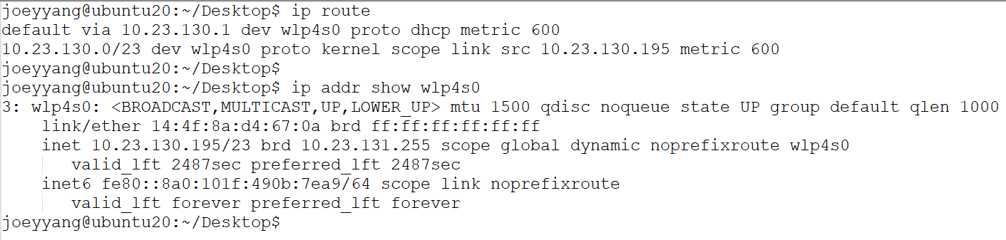
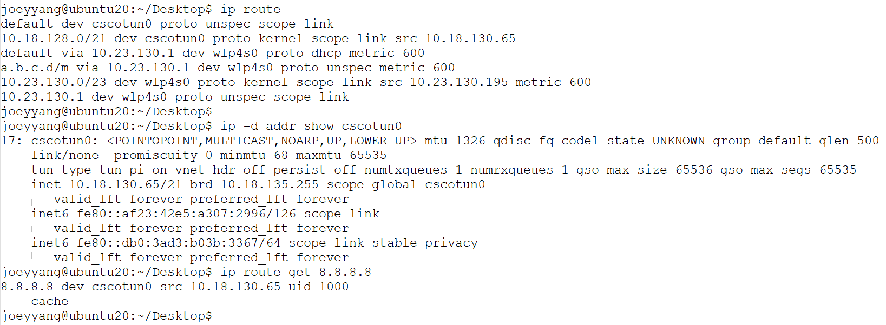
OpenVPN application
Check ip address and ip route before connecting VPN to a site
Check ip address and ip route after connecting VPN to a site

Slide 21
Break 3

Slide 22
Hand CNI - 8 Containers connected under Linux bridges on different nodes – Static route
Diagram(container-to-container)
netns1
192.168.10.1/24
netns1
192.168.30.1/24
eth0
eth0
veth1
veth1
br0
192.168.10.254/24
br0
192.168.30.254/24
worker1.k8s.com
enp0s9
192.168.210.21/24
worker3.k8s.com
enp0s9
192.168.230.23/24
Route | NextHop
192.168.210.0/24 | swp1
192.168.230.0/24 | swp2
192.168.10.0/24 | 192.168.210.21
192.168.20.0/24 | 192.168.210.22
192.168.30.0/24 | 192.168.230.23
br0
192.168.20.254/24
enp0s9
192.168.210.22/24
swp1
192.168.210.254/24
swp2
192.168.230.254/24
worker2.k8s.com

Slide 23
Hand CNI - 9 Containers connected under Linux bridges on different nodes – BGP
Diagram(container-to-container)
netns1
192.168.10.1/24
netns1
192.168.30.1/24
eth0
eth0
veth1
veth1
br0
192.168.10.254/24
br0
192.168.30.254/24
worker1.k8s.com
enp0s9
192.168.210.21/24
worker3.k8s.com
enp0s9
192.168.230.23/24
Route | NextHop
192.168.210.0/24 | swp1
192.168.230.0/24 | swp2
192.168.10.0/24 | 192.168.210.21
192.168.20.0/24 | 192.168.210.22
192.168.30.0/24 | 192.168.230.23
br0
192.168.20.254/24
enp0s9
192.168.210.22/24
swp1
192.168.210.254/24
swp2
192.168.230.254/24
worker2.k8s.com
Notes:
# apt install bird
# cat /etc/bird/bird.conf
# This is a minimal configuration file, which allows the bird daemon to start
# but will not cause anything else to happen.
#
# Please refer to the documentation in the bird-doc package or BIRD User's
# Guide on http://bird.network.cz/ for more information on configuring BIRD and
# adding routing protocols.
# Change this into your BIRD router ID. It's a world-wide unique identification
# of your router, usually one of router's IPv4 addresses.
router id 192.168.210.22;
# The Kernel protocol is not a real routing protocol. Instead of communicating
# with other routers in the network, it performs synchronization of BIRD's
# routing tables with the OS kernel.
protocol kernel {
scan time 60;
import all;
export all; # Actually insert routes into the kernel routing table
}
# The Device protocol is not a real routing protocol. It doesn't generate any
# routes and it only serves as a module for getting information about network
# interfaces from the kernel.
protocol device {
scan time 60;
}
protocol direct {
interface "br0";
}
protocol bgp upstream {
import all;
export where source = RTS_DEVICE;
local as 65002;
source address 192.168.210.22;
neighbor 192.168.210.254 as 65000;
}

Slide 24
Kubernetes CNI introduction
https://www.cni.dev/plugins/current/

Slide 25
What does a CNI do?
IPAM(IP address+Subnetmask, routes)
Node level
Cluster level
Connect Pod to others
Pod to Pod on the same node
Pod to Pod on the different nodes(Tunnel, Routing), mustn’t have NAT
Pod to Outside
Pod to Service(ClusterIP)
Outside to Service(NodePort)

Slide 26
Break 4

